Slide 1
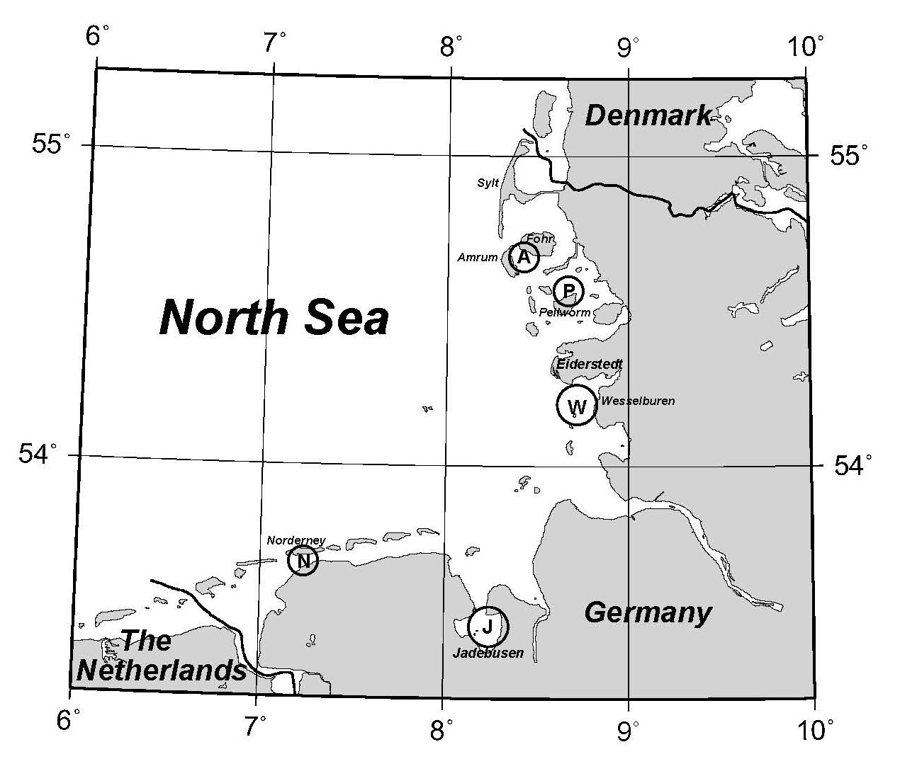
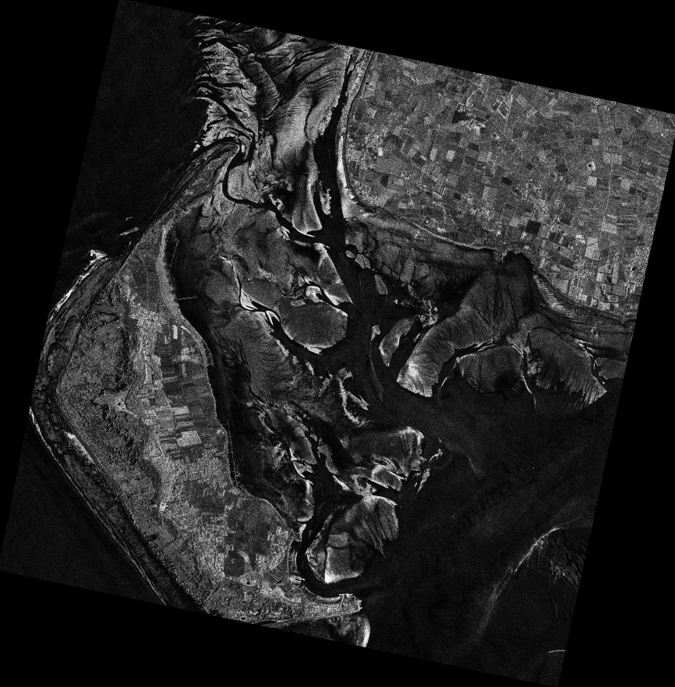
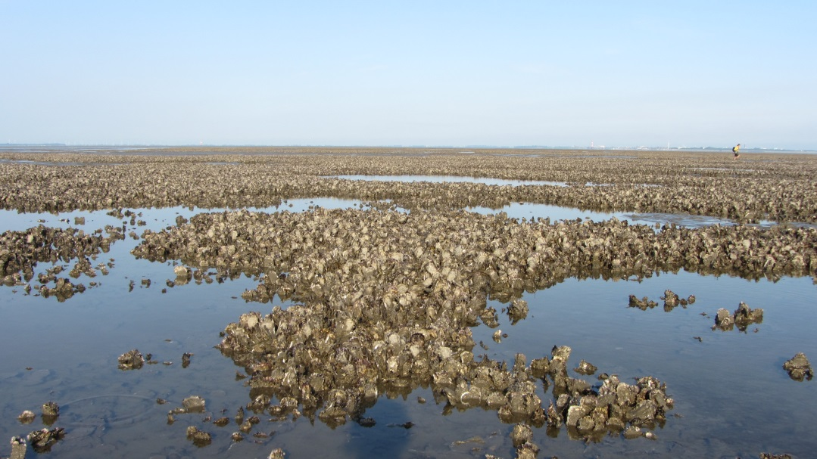
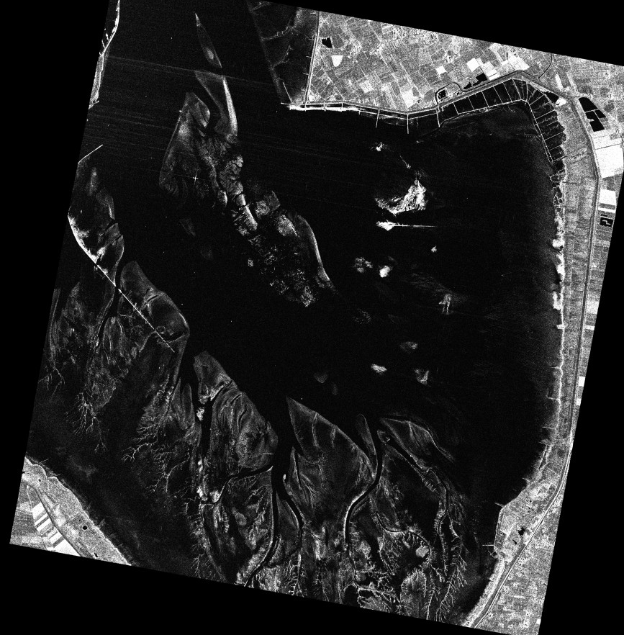
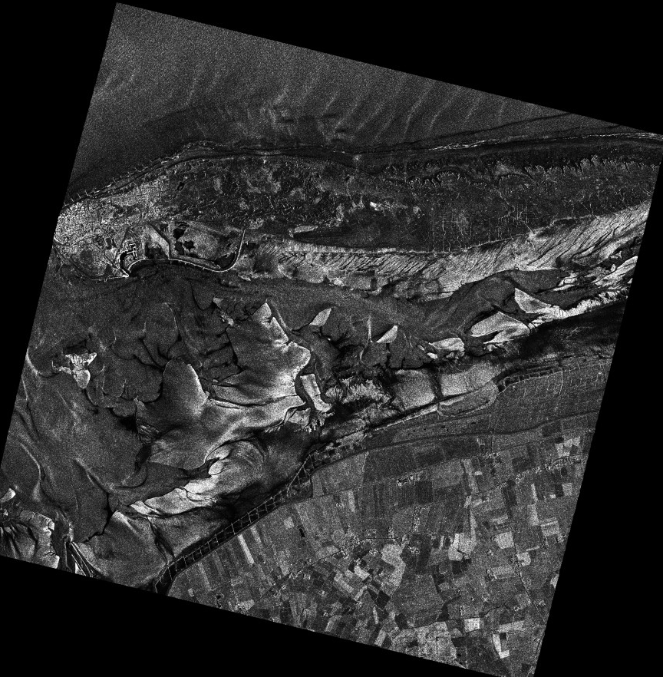
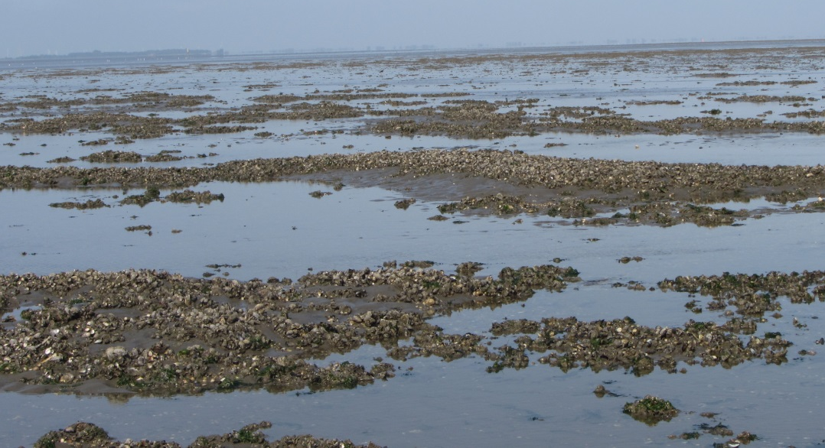
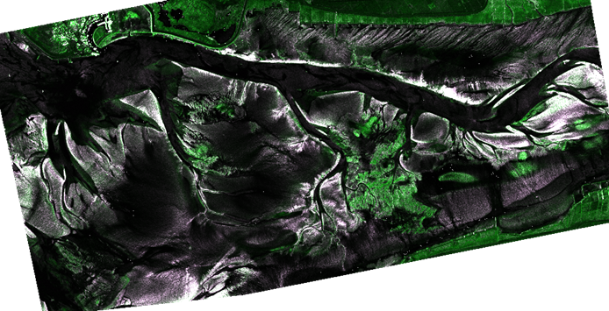
Bivalve Beds Detection on Intertidal Flats
on the German North Sea Coast
Based on Synthetic Aperture Radar Observations
Sabrina Melchionna¹ and Martin Gade¹
¹University of Hamburg, Institute of Oceanography, Hamburg, Germany
Intertidal flats are coastal areas that fall dry once during each tidal cycle. Remote sensing techniques are ideally suited for the surveillance of these areas that are generally difficult to access. In this respect, Synthetic Aperture Radar (SAR) sensors, because of their all-weather capabilities and their independence on daylight, may be the first choice; however, radar imaging is rather complex, and the very processes responsible for the backscattering of microwaves by bare soils are still subject to research.
We demonstrate that multi-polarized, multi-frequency, and multi-temporal SAR imagery can be used to detect bivalve beds on exposed intertidal flats.
In 2012 and 2013, within the German national project SAMOWatt (“SAR Monitoring of the Wadden Sea”), a considerable number of SAR images from TerraSAR-X (X-band, horizontally (HH) and vertically (VV) polarized) and Radarsat-2 (C-band, VV polarized) of five test areas along the German North Sea coast were acquired close to low tide. The test areas represent regions of typical sediment distributions on intertidal flats, and include vegetated areas and bivalve beds. In each test area we identified the approximate locations of bivalve beds by using in-situ data from field campaigns carried out in 2006, 2012, and 2013. In order to understand which are the more advantageous bands, polarization channels, or combinations of them, that are best suited to detect these structures on intertidal flats, we focused our analyses on:
the Normalized Radar Cross Section (NRCS) at at X-band, VV and HH polarization (σ_{X-VV} and σ_{X-HH}, respectively), and at C-band, VV-polarization (σ_{C-VV});
the Polarization Coefficient (PC), as function of the two polarization channels at X-band: $PC= \frac{σ_{X−HH} − σ_{X−VV}}{σ_{X−HH} + σ_{X−VV}}$ ;
the Band Coefficient (BC), function of the two frequency bands at vertical polarization: $BC= \frac{σ_{X−VV} − σ_{C−VV}}{σ_{X−VV} + σ_{C−VV}}$ ;
mean and standard deviation of multi-temporal NRCS data.
We found that bivalve beds can be detected at all available bands and polarization channels due to their high NRCS values; however, edges of the tidal channels present similar values. In order to distinguish between bivalve beds and channel edge areas, we benefit of the different roughness characteristics they show in the multi-temporal approach, the former showing high mean NRCS and low NRCS standard deviation, the latter showing high mean NRCS and high NRCS standard deviation.
Likewise, we observed a markable contrast between bivalve beds and their surroundings in the polarization coefficient, whose values smoothly fluctuate for bivalve beds and have a rough texture elsewhere.
We also observed that the band coefficient values underline a characteristic spatial distribution of oysters, which grow in parallel banks.
Multi-polarized, multi-frequency, and multi-temporal analyses of high resolution SAR data provide, therefore, valuable input for the detection of bivalve beds, as much as for the routine monitoring of exposed intertidal flats on the German North Sea coast. The potential of our approach for an improved sediment classification is currently under investigation.
Test Areas and Regions of Interest
Detail (2km × 2km). Blue contours: profile of bivalve beds, field campaign of 2012.
Amrum: TerraSAR-X, HH-pol., 11km × 11km, acquired 05.06.2013, 05:50 UTC (low tide 04:11 UTC)
1
Test areas on the German North Sea coast.
A: Amrum; P: Pellworm; W: Wesselburen; N: Norderney; J: Jadebusen
2
Detail (2km × 2km). Blue contours: profile of bivalve beds, field campaign of 2006.
Jadebusen: TerraSAR-X, VV-pol., 11km × 11km, acquired 14.11.2012, 05:42 UTC (low tide 05:35 UTC)
Details (1.5km × 2km). Blue contours: profile of bivalve beds, field campaign of 2012; red dashed contours: profile of bivalve beds based on TSX imagery of 2013.
Photographs of extended bivalve beds in the test area “Jadebusen” (S. Melchionna). Upper panel: oysters; lower panel: clams and mussels.
Norderney: TerraSAR-X, VV-pol., 12 km × 12k m, acquired 17.08.2012, 05:59 UTC (low tide 04:17 UTC)
Multi-Temporal SAR Data Analysis
Multi-Polarization and
Multi-Frequency
SAR Data Analysis
1a
Multi-temporal analyses of TSX SAR imagery (9km × 4km) of “Pellworm” test area. Shown are false color composites of the mean (green) and the standard deviation (magenta) of 5 TSX images acquired in 2009.
Polarization Coefficient PC (a) and Band Coefficient BC (b) for above panels (1) and (2), test area “Jadebusen”. Black dashed contours: profile of bivalve beds based from TSX imagery of 2013.
2a
2b
1b

